Slide 1





MAMC01901 Business Analysis
Week 2 (Session 1): Skills, competencies and soft skills of business analysts

Slide 2



Agenda
Skills and competencies of a business analyst
Business analysts in different business functions
Assessment 1 requirements

Slide 3
Skills, Competencies & Soft Skills of a Business Analyst
Technical & Business Skills
Analytical Thinking & Problem Solving
Ability to break down complex problems and find effective solutions.
✅ Example: A BA identifies that delays in delivery stem from poor route planning and recommends a software tool to optimise logistics.
Business Knowledge
Understanding how the business or industry works, including processes, policies, and customer expectations.
✅ Example: At a supermarket chain, the BA uses knowledge of supply chains to help digitise restocking processes.
Technology & Tools Proficiency
Comfort with tools like Power BI, Jira, Visio, SQL, or process modelling software.
✅ Example: A BA uses Power BI dashboards to track customer buying trends and support marketing decisions.

Slide 4
Skills, Competencies & Soft Skills of a Business Analyst
Technical & Business Skills (Contd.)
Conceptual Thinking
Ability to connect high-level strategy with detailed implementation.
✅ Example: When redesigning a loyalty program, the BA ensures that both business goals and customer experience are aligned.
Decision-Making
Assessing trade-offs and choosing solutions that provide the most value.
✅ Example: A BA helps decide whether to build a feature in-house or buy a third-party tool based on cost-benefit analysis.
Time Management & Prioritisation
Handling multiple tasks, deadlines, and meetings efficiently.
✅ Example: A BA organises stakeholder meetings in advance and breaks the project into manageable weekly sprints.

Slide 5
Skills, Competencies & Soft Skills of a Business Analyst
Soft Skills & Interpersonal Competencies
Communication Skills
Clearly conveying ideas and actively listening to stakeholders.
✅ Example: A BA explains complex tech terms in simple language so that non-technical staff understand system changes.
Stakeholder Engagement
Identifying all relevant stakeholders and building strong relationships.
✅ Example: A BA includes warehouse workers in requirements workshops for a new inventory system to ensure real needs are met.
Facilitation Skills
Leading workshops and meetings to gather input, align views, and make decisions.
✅ Example: A BA runs a user story mapping session to prioritise features for an app redesign.
Negotiation & Conflict Resolution
Balancing different needs and reaching fair outcomes.
✅ Example: The sales team wants a quick launch; IT needs more time. The BA negotiates a phased rollout to satisfy both.

Slide 6
Skills, Competencies & Soft Skills of a Business Analyst
Soft Skills & Interpersonal Competencies (Contd.)
Teaching & Mentoring
Helping others understand new processes, tools, or systems.
✅ Example: A BA runs a training session for staff learning to use a new CRM tool.
Adaptability
Responding effectively to change, especially in Agile projects.
✅ Example: Midway through a project, the client’s priorities change, and the BA quickly reshapes the backlog to reflect this.
Ethical Behaviour & Trustworthiness
Acting with integrity and maintaining confidentiality.
✅ Example: A BA ensures sensitive customer data is protected while analysing trends for a marketing campaign.

Slide 7
Skills, Competencies & Soft Skills of a Business Analyst
Extra Focus: Risk Management
Risk Awareness & Mitigation
Identifying potential risks early and suggesting ways to manage them.
✅ Example: A BA warns that launching a feature without staff training could cause service issues and proposes a pilot phase.

Slide 8
Example: Countdown Supermarkets
Project: Implementing a click-and-collect grocery service across stores
Analytical Thinking & Problem Solving (Core Competency)
Critical Thinking
Evaluating ideas and identifying best-fit solutions.
✅ Example: The BA notices that customer wait times are high and recommends redesigning the pickup process for efficiency.
Decision-Making
Making informed, balanced decisions using available data.
✅ Example: The BA compares the cost and speed of in-house development vs third-party software to select the most cost-effective system.
Conceptual Thinking
Connecting high-level business goals with operational details.
✅ Example: The BA ensures the click-and-collect service aligns with Countdown’s larger goal of improving convenience and customer loyalty.

Slide 9
Example: Countdown Supermarkets
Business Knowledge & Industry Expertise (Business Competency)
Domain Knowledge
Understanding how a specific business or industry operates.
✅ Example: The BA knows how grocery store operations work (inventory, staffing, customer flow), which helps design a service that integrates smoothly with existing systems.
Organisational Knowledge
Being familiar with internal policies, culture, and priorities.
✅ Example: The BA understands that Countdown stores vary in size and staff capacity, so proposes a phased rollout for smaller stores.

Slide 10
Example: Countdown Supermarkets
Technical Proficiency (Technical Competency)
Tool Usage
Proficiency in software like Power BI, Jira, or process modelling tools.
✅ Example: The BA uses Power BI to analyse order data and identify which stores experience high demand, helping prioritise where to expand the service next.
Data Analysis
Interpreting data trends to inform decisions.
✅ Example: The BA studies past online sales to estimate expected order volumes for click-and-collect at each location.

Slide 11
Example: Countdown Supermarkets
Communication & Interpersonal Skills (Behavioural Competency)
Verbal & Written Communication
Conveying ideas clearly and adjusting language to suit the audience.
✅ Example: The BA writes a business case for senior management and presents it in a clear, concise way.
Facilitation
Leading productive meetings, workshops, and discussions.
✅ Example: The BA facilitates a user story mapping session with IT and operations teams to define customer journey steps.
Stakeholder Engagement
Identifying and collaborating with people affected by the project.
✅ Example: The BA involves store managers and front-line staff early to understand their concerns and gather input.

Slide 12
Example: Countdown Supermarkets
Negotiation & Conflict Resolution
Balancing competing priorities and reaching agreements.
✅ Example: When IT wants a secure but complex solution and store staff need ease-of-use, the BA negotiates a compromise design.
Teaching & Mentoring
Explaining concepts to others or guiding team members.
✅ Example: The BA trains store staff on how to process and manage click-and-collect orders through the new system.

Slide 13
Example: Countdown Supermarkets
Agility & Personal Effectiveness (Behavioural & Personal Attributes)
Adaptability
Adjusting quickly to changes in scope, goals, or team structure.
✅ Example: When management decides to include frozen items in the service, the BA quickly updates requirements and workflows.
Time Management & Organisation
Managing tasks efficiently and meeting deadlines.
✅ Example: The BA organises the delivery of system updates across multiple stores without disrupting daily operations.
Ethical Behaviour & Trustworthiness
Handling sensitive information responsibly and acting with integrity.
✅ Example: The BA ensures customer data collected during online orders is stored securely and in compliance with privacy laws.

Slide 14
Example: Countdown Supermarkets
Risk Management & Strategic Thinking (Strategic & Risk Competency)
Risk Identification and Mitigation
Spotting potential issues and planning how to avoid them.
✅ Example: The BA flags that smaller stores may not have space for large order storage, and proposes a scheduling system to spread out pickups.
Strategic Alignment
Ensuring the project supports the organisation’s long-term goals.
✅ Example: The BA ensures the new service supports Countdown’s digital transformation and customer satisfaction targets.

Slide 15
Business Analysts in Different Business Functions
Business Analysts (BAs) can play a crucial role in improving multiple business functions within the same organisation by identifying inefficiencies, aligning processes with strategy, and supporting data-driven decision-making.
Operations
Role of BA: Streamline processes, reduce costs, and increase efficiency.
How:
Map current workflows and identify bottlenecks.
Recommend process automation tools (e.g., inventory or logistics systems).
✅ Example: A BA at a retail chain identifies redundant manual inventory tracking and proposes an automated stock system, reducing errors and labour hours.
Finance
Role of BA: Improve budgeting, forecasting, and financial decision-making.
How:
Analyse expenditure trends and financial reports.
Build dashboards for real-time financial KPIs.
✅ Example: At a healthcare provider, a BA helps the finance team optimise budget allocation by analysing underperforming service lines and proposing cost-saving measures.

Slide 16
Business Analysts in Different Business Functions
Sales & Marketing
Role of BA: Enhance customer targeting and campaign effectiveness.
How:
Use data analytics to segment customers and identify trends.
Evaluate marketing ROI and suggest improvements.
✅ Example: A BA in an e-commerce company uses customer purchase data to suggest targeted email campaigns, improving conversion rates.
Human Resources (HR)
Role of BA: Support strategic workforce planning and employee engagement.
How:
Analyse hiring, retention, and training data.
Design HR dashboards to monitor team performance and satisfaction.
✅ Example: A BA helps HR at a tech firm reduce employee turnover by identifying pain points in onboarding and suggesting a structured training program.

Slide 17
Business Analysts in Different Business Functions
IT & Digital Transformation
Role of BA: Bridge the gap between business needs and technical solutions.
How:
Gather requirements for system upgrades or new platforms.
Prioritise IT projects based on business impact.
✅ Example: A BA helps select and implement a new CRM system that aligns with both sales needs and IT capabilities.
A skilled Business Analyst doesn't just work within one silo — they:
Connect cross-functional teams.
Ensure strategic alignment across departments.
Use data to improve performance holistically.

Slide 18
Group Activity: BrightMart Case Study
Instructions:
Carefully read the case study on teams and answer the following questions:
What organisational context and internal factors led BrightMart to hire a business analyst?
Which business functions did the analyst work to improve?
How did the analyst work to improve the business functions at BrightMart?
Identify the specific information the analyst had to gather in order to improve each function.
Identify the key activities the analyst likely undertook in each function.
What challenges can you identify that the analyst faced in each business function?
What were the outcomes of the improvements in each function?

Slide 19

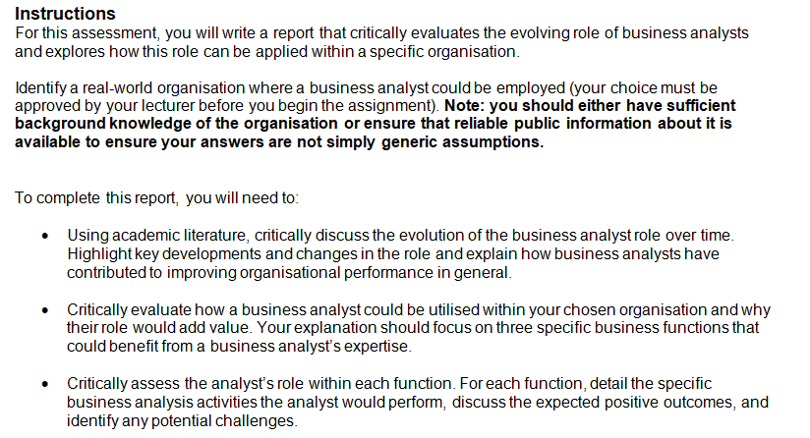
Assessment 1: Report (30% to final grade)
Word count guidance: 1500 words
Due date: Friday Week 3 (16th May 2025), 9:00 AM

Slide 20
Assessment 1 Breakdown/Homework
Discuss how the role of Business Analysts have evolved over time and how they have contributed to improve organisational performance in general.
Identify an organisation where a business analyst could be employed.
Identify 3 business functions (operations, IT, marketing etc) in the organisation where a business analyst can be utilised.
Evaluate how the business analyst could be utilised in your chosen organisation to improve each of the 3 business functions.
For each function, outline specific business analysis activities, discuss the expected positive outcomes of those activities and address any potential challenges the analyst may face.
*Use and cite contemporary literature (journal articles or conference papers) wherever applicable*

Slide 21
Assessment 1 Breakdown/Homework
Assignment 1 draft due on Thursday, 8th May, 11.59 PM. Send via teams.

